Slide 1

Machine Learning Based Error Detection in Networks CSA0720 – Computer Networks
Guided by
Dr. AGNES SHIFANI
Presented by
K Suthesika – 192511070
S Santhiya – 192511360

Slide 2
Introduction
What is Error Detection?
Error detection is the process of identifying errors that occur during data transmission over a network.
Traditional methods include:
Parity Check
Checksum
CRC (Cyclic Redundancy Check)
These methods detect transmission errors but cannot identify complex attack patterns or abnormal network behavior.

Slide 3
Why Machine Learning?
Traditional Methods
Rule-based
Detect only known transmission errors
Limited adaptability
Machine Learning
Learns from network data
Detects hidden patterns
Identifies anomalies automatically
Improves detection accuracy over time

Slide 4
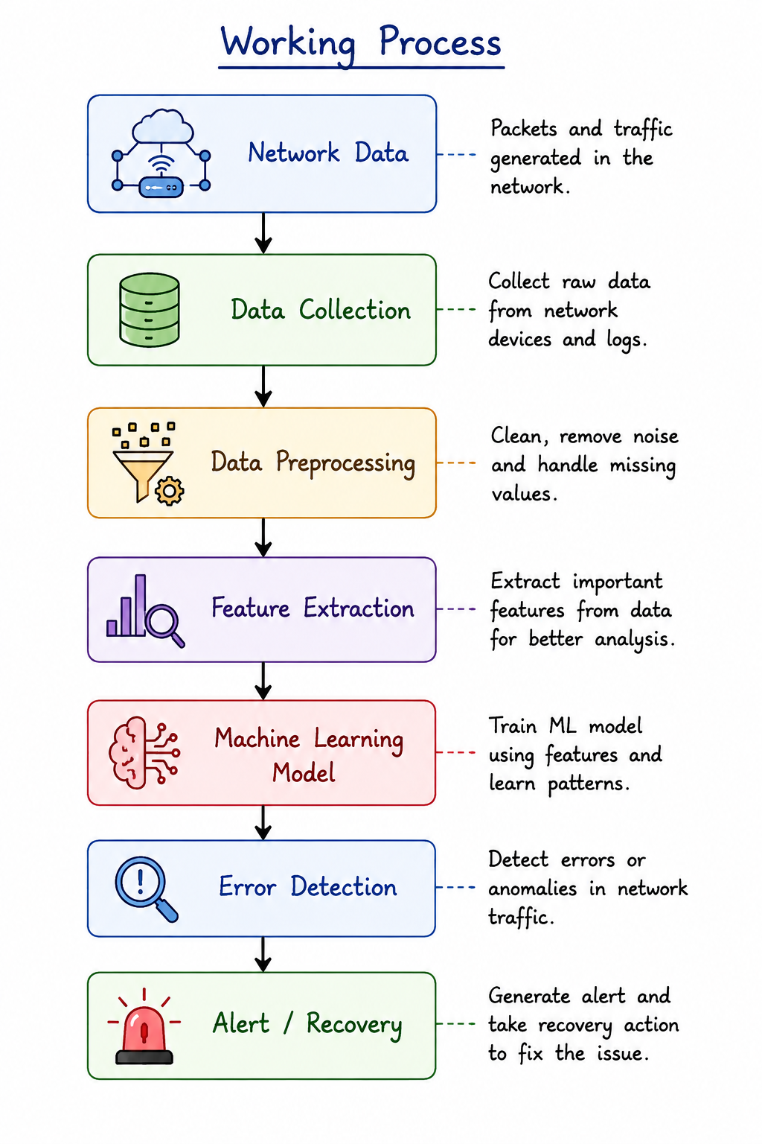

Slide 5
Machine Learning Algorithms
Some common algorithms are:
Decision Tree
Random Forest
Support Vector Machine (SVM)
Neural Networks
Deep Learning
K-Means Clustering (for anomaly detection)

Slide 6
Advantages
High accuracy
Detects unknown errors
Learns automatically
Real-time monitoring
Reduces manual work
Improves network reliability

Slide 7
Applications
Machine learning based error detection is used in:
Computer Networks
Cloud Computing
Data Centers
IoT Networks
Wireless Networks
5G Networks
Cybersecurity
Banking Networks

Slide 8
Challenges and Future Scope
Future developments include:
AI-powered self-healing networks
6G communication
Intelligent routing
Edge AI
Autonomous network management
Large amount of training data required
High computational cost
False positives
Model needs regular updates
Privacy concerns

Slide 9
Conclusion
Machine Learning improves traditional error detection by learning from network traffic.
It provides:
Faster detection
Better accuracy
Real-time monitoring
Intelligent decision making
Therefore, Machine Learning is becoming an essential technology for modern communication networks.

Slide 10


